Slide 1

Python Programming Language

Slide 2

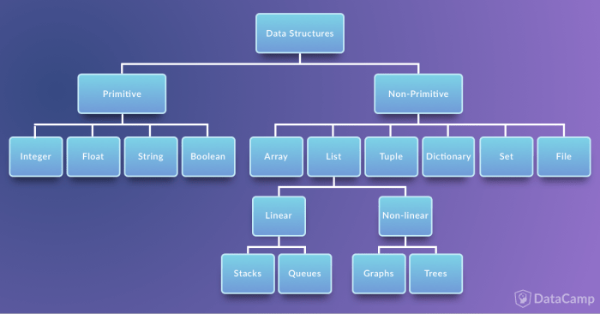
Data structures
Data structures are a way of organizing and storing data so that they can be accessed and worked with efficiently.
T Seshu Chakravarthy Department Of Computer Science and Engineering

Slide 3
Data Types in Python
Numbers
Booleans
Strings
List
Tuple
Set
Dictionary
T Seshu Chakravarthy Department Of Computer Science and Engineering

Slide 4
List
Lists in Python are used to store collection of heterogeneous items.
Lists are used to store multiple items in a single variable.
List items are ordered, changeable, and allow duplicate values.
List items are indexed, the first item has index [0], the second item has index [1] etc.
Ex:
list1 = ['physics', 'chemistry', 1997, 2000];
list2 = [1, 2, 3, 4, 5 ];
T Seshu Chakravarthy Department Of Computer Science and Engineering

Slide 5
How to create a list?
In Python programming, a list is created by placing all the items (elements) inside a square bracket [ ], separated by commas.
It can have any number of items and they may be of different types (integer, float, string etc.).
list my_list = []
my_list = [1, 2, 3]
my_list = [1, "Hello", 3.4]
Also, a list can even have another list as an item. This is called nested list.
my_list = ["mouse", [8, 4, 6], ['a']]
T Seshu Chakravarthy Department Of Computer Science and Engineering

Slide 6
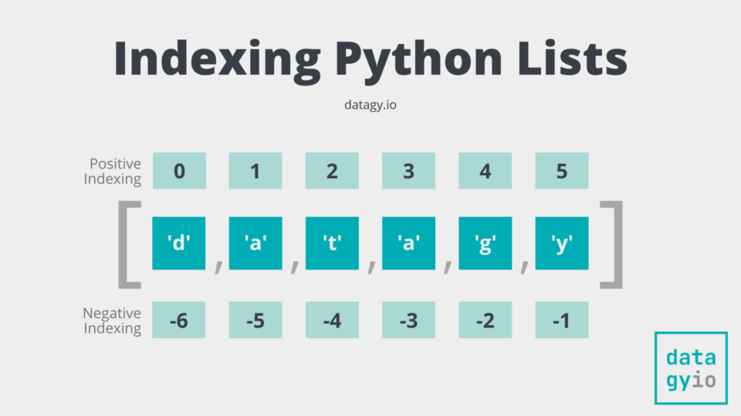
How to access elements from a list?
List items are indexed and you can access them by referring to the index number
We can use the index operator [] to access an item in a list.
Index starts from 0. So, a list having 5 elements will have index from 0 to 4.
Trying to access an element out of range index then it will raise an IndexError.
The index must be an integer. We can't use float or other types, this will result into TypeError.
Negative indexing
Python allows negative indexing for its sequences.
The index of -1 refers to the last item, -2 to the second last item and so on.
T Seshu Chakravarthy Department Of Computer Science and Engineering

Slide 7
How to access elements from a list?
thislist = ["apple", "banana", "cherry"] print(thislist[1])
banana
thislist = ["apple", "banana", "cherry"] print(thislist[-1])
cherry
Range of Indexes
You can specify a range of indexes by specifying where to start and where to end the range.
When specifying a range, the return value will be a new list with the specified items.
thislist = ["apple", "banana", "cherry", "orange", "kiwi", "melon"]
print(thislist[2:5])
['cherry', 'orange', 'kiwi']
T Seshu Chakravarthy Department Of Computer Science and Engineering

Slide 8
How to access elements from a list?
thislist =["apple", "banana", "cherry", "orange", "kiwi"] print(thislist[:3])
['apple', 'banana', 'cherry’,]
thislist = ["apple", "banana", "cherry", "orange", "kiwi"]
print(thislist[2:])
['cherry', 'orange', 'kiwi']
thislist = ["apple", "banana", "cherry", "orange", "kiwi"]
print(thislist[-4:-1])
['banana', 'cherry', 'orange']
T Seshu Chakravarthy Department Of Computer Science and Engineering

Slide 9
Change List Items
To change the value of a specific item, refer to the index number:
thislist = ["apple", "banana", "cherry"]
thislist[1] = "blackcurrant"
print(thislist)
['apple', 'blackcurrant', 'cherry']
thislist = ["apple", "banana", "cherry", "orange", "kiwi", "mango"] thislist[1:3] = ["blackcurrant", "watermelon"] print(thislist)
['apple', 'blackcurrant', 'watermelon', 'orange', 'kiwi', 'mango']
T Seshu Chakravarthy Department Of Computer Science and Engineering

Slide 10
Add List Items
Append Items:
To add an item to the end of the list, use the append() method:
thislist = ["apple", "banana", "cherry"] thislist.append("orange") print(thislist)
Insert Items:
The insert() method inserts an item at the specified index:
['apple', 'banana', 'cherry', 'orange']
thislist = ["apple", "banana", "cherry"] thislist.insert(1, "orange") print(thislist)
['apple', 'orange', 'banana', 'cherry']
T Seshu Chakravarthy Department Of Computer Science and Engineering

Slide 11
Remove List Items
Remove Specified Item:
The remove() method removes the specified item.
thislist = ["apple", "banana", "cherry"] thislist.remove("banana") print(thislist)
If there are more than one item with the specified value, the remove() method removes the first occurrence:
Remove Specified Index:
The pop() method removes the element at specified index.
thislist = ["apple", "banana", "cherry"] thislist.pop(0) print(thislist) ['banana', 'cherry’]
If you do not specify the index, the pop() method removes the last item.
thislist = ["apple", "banana", "cherry"] thislist.pop() print(thislist)
['apple', 'cherry']
['apple', 'banana']
T Seshu Chakravarthy Department Of Computer Science and Engineering

Slide 12
Loop Through a List
You can loop through the list items by using a for loop
thislist = ["apple", "banana", "cherry"] for x in thislist: print(x)
apple
banana
cherry
Loop Through the Index Numbers:
You can also loop through the list items by referring to their index number.
Use the range() and len() functions to create a suitable iterable.
Example: Print all items by referring to their index number:
list = ["apple", "banana", "cherry"]
n=len(list)
for i in range(n):
print(list[i])
apple
banana
cherry
Practice program: Print all items, using a while loop
T Seshu Chakravarthy Department Of Computer Science and Engineering

Slide 13
Given a list of numbers. write a program to turn every item of a list into its square.
Given:
numbers = [1, 2, 3, 4, 5, 6, 7]
Expected output:
[1, 4, 9, 16, 25, 36, 49]
Program:
numbers = [1, 2, 3, 4, 5, 6, 7]
res=[]
for i in numbers:
res.append(i*i)
print("Input:",numbers)
print("Output:",res)
Input: [1, 2, 3, 4, 5, 6, 7]
Output: [1, 4, 9, 16, 25, 36, 49]
T Seshu Chakravarthy Department Of Computer Science and Engineering

Slide 14
Methods Of list
animal = ['cat', 'dog', 'rabbit']
len(): It returns the number of elements in the list.
Print(len(animal))
extend():it adds all items of a one list to the end of another list.
syntax:
list1.extend(list2)
Here, the elements of list2 are added to the end of list1.
language = ['French', 'English', 'German']
language1 = ['Spanish', 'Portuguese']
language.extend(language1)
print('Language List: ', language)
Output:
Language List: ['French', 'English', 'German', 'Spanish', 'Portuguese']
T Seshu Chakravarthy Department Of Computer Science and Engineering

Slide 15
Methods Of list
count(): method returns the number of occurrences of an element in a list.
Syntax: list.count(element)
vowels = ["C","Python","java","Python"]
count = vowels.count('Python')
print(count) #2
sum() : Calculates sum of all the elements of List. Syntax: sum(List)
List = [1, 2, 3, 4, 5]
print(sum(List))
Output:
2
T Seshu Chakravarthy Department Of Computer Science and Engineering

Slide 16
Methods Of list
min() : Calculates minimum of all the elements of List. Syntax: min(List)
List = [2, 4, 3, 5, 1, 2.5]
print(min(List)) #1
max(): Calculates maximum of all the elements of List. Syntax: max(List)
List = [2, 4, 3, 5, 1, 2.5]
print(max(List)) #5.
T Seshu Chakravarthy Department Of Computer Science and Engineering

Slide 17
Methods Of list
sort() method can be used to sort List with Python in ascending or descending order.
numbers = [1, 3, 4, 2]
# Sorting list of Integers in ascending
print(numbers.sort())
print(numbers)
strs = ["geeks", "code", "ide", "practice"]
strs.sort()
print(strs)
#['code', 'geeks', 'ide', 'practice']
# [1, 2, 3, 4]
numbers = [1, 3, 4, 2]
numbers.sort(reverse=True)
print(numbers)
# [4, 3, 2, 1]
T Seshu Chakravarthy Department Of Computer Science and Engineering

Slide 18
Write a python program to read items from the user and display items in the list?
L=[]
n=int(input("enter size of list"))
i=0
while(i<n):
a=int(input())
L.append(a)
i=i+1
for j in L:
print(j)
T Seshu Chakravarthy Department Of Computer Science and Engineering

Slide 19
Python program that search for a specific element in a list
list=[5,6,7,8,9]
num=int(input("enter element to search"))
for i in list:
if i==num:
print(num,"found in the list")
break
else:
print(num,"not found in the list")
enter element to search 8
8 found in the list
enter element to search 20
20 not found in the list
T Seshu Chakravarthy Department Of Computer Science and Engineering

Slide 20
Write a python program to find the largest element in a list without using method
list=[1,2,4,7,3]
max=list[0]
for a in list:
if a > max:
max = a
print("largets is",max)
T Seshu Chakravarthy Department Of Computer Science and Engineering

Slide 21
create a Python program to count the number of strings in a list that have a length of 3 or more and where the first and last characters are the same
string_list = ["level", "python", "radar", "hh", "noon"]
count = 0
for word in string_list:
if len(word) >= 3 and word[0] == word[-1]:
count += 1
print("Count is:", count)
T Seshu Chakravarthy Department Of Computer Science and Engineering

Slide 22
List Comprehension:
List comprehension is an elegant and concise way to create new list from an existing list in Python.
List comprehension consists of an expression followed by for statement inside square brackets.
pow2 = [2 ** x for x in range(10)]
print(pow2)
# Output: [1, 2, 4, 8, 16, 32, 64, 128, 256, 512]
T Seshu Chakravarthy Department Of Computer Science and Engineering

Slide 23
tuple
A tuple is a collection of elements separated by commas.
Tuple items are ordered, unchangeable, and allow duplicate values.
Since tuple are unchangeable, iterating through tuple is faster than with list.
T Seshu Chakravarthy Department Of Computer Science and Engineering

Slide 24
Creating a Tuple
A tuple is created by placing all the items (elements) inside a parentheses (), separated by comma.
A tuple can have any number of items and they may be of different types (integer, float, list, string etc.).
my_tuple = ()
my_tuple = (1, 2, 3)
my_tuple = (1, "Hello", 3.4)
my_tuple = ("mouse", [8, 4, 6], (1, 2, 3))
my_tuple = 3, 4.6, "dog"
T Seshu Chakravarthy Department Of Computer Science and Engineering

Slide 25
Accessing Elements in a Tuple
Indexing:
We can use the index operator [] to access an item in a tuple where the index starts from 0.
The index must be an integer, so we cannot use float or other types. This will result into TypeError
Negative Indexing
Python allows negative indexing for its sequences.
The index of -1 refers to the last item, -2 to the second last item and so on.
Slicing
We can access a range of items in a tuple by using the slicing operator - colon ":".
T Seshu Chakravarthy Department Of Computer Science and Engineering

Slide 26
Accessing Elements in a tuple
my_tuple = ('python','java','C','C++’)
print(my_tuple[3])
print(my_tuple[-2])
print(my_tuple[1:3])
print(my_tuple[:])
t=(1,2,3)
t[0] = 5
n_tuple = ("mouse", [8, 4, 6], (1, 2, 3))
print(n_tuple[1])
print(n_tuple[0][1])
print(n_tuple[2][2])
T Seshu Chakravarthy Department Of Computer Science and Engineering

Slide 27
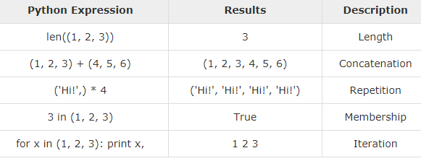
Basic tuple Operations
T Seshu Chakravarthy Department Of Computer Science and Engineering

Slide 28
Methods
t=(1,4,5,3,8)
print(sum(t))
print(max(t))
print(min(t))
T=(1,5,3,2,5)
print(T. count(5)) # 2
T Seshu Chakravarthy Department Of Computer Science and Engineering

Slide 29
Methods
tuple(): converts a list of items into tuples
L=[1,5,3]
T=tuple( L )
print(T)
Sorted():
p = ('e', 'a', 'u', 'o', 'i')
print(sorted(p))
print(sorted(p,reverse=True))
['a', 'e', 'i', 'o', 'u’]
['u', 'o', 'i', 'e', 'a']
T Seshu Chakravarthy Department Of Computer Science and Engineering

Slide 30
Even and Odd sum in a tuple
t=(1,2,3,4,5)
sume=0
sumo=0
for i in t:
if(i%2==0):
sume=sume+i
else:
sumo=sumo+i
print(sume)
print(sumo)
T Seshu Chakravarthy Department Of Computer Science and Engineering

Slide 31
python set
A set is an unordered collection of items.
All the elements in the set are unique.
Sets can be used to perform mathematical set operations like union, intersection, symmetric difference etc.
How to create a set:
A set is created by placing all the elements inside curly braces {}, separated by comma or by using the built-in function set().
It can have any number of items and they may be of different types (integer, float, tuple, string etc.).
my_set = {1, 2, 3}
my_set = set([1,2,3])
my_set = {1,2,3,4,3,2} # {1,2,3,4}
T Seshu Chakravarthy Department Of Computer Science and Engineering

Slide 32
Access Items
We cannot access or change an element of set using indexing or slicing.
But you can loop through the set items using a for loop
thisset = {"apple", "banana", "cherry"}
for x in thisset:
print(x)
cherry banana apple
T Seshu Chakravarthy Department Of Computer Science and Engineering

Slide 33
Join Two Sets or Python Set Operations
The union() method that returns a new set containing all items from both sets
The intersection() method will return a new set, that only contains the items that are present in both sets.
Difference of A and B (A - B) is a set of elements that are only in A but not in B
The symmetric_difference() method will return a new set, that contains only the elements that are NOT present in both sets.
Program:
A = {1, 2, 3, 4, 5}
B = {4, 5, 6, 7, 8}
print(A.union(B)) #{1, 2, 3, 4, 5, 6, 7, 8}
print(A.intersection(B)) #{4, 5}
print(A.difference(B)) #{1, 2, 3}
print(A.symmetric_difference(B)) # {1, 2, 3, 6, 7, 8}
T Seshu Chakravarthy Department Of Computer Science and Engineering

Slide 34
Python Set Methods
add() : It adds a given element to a set. If the element is already present, it doesn't add any element.
v = {'a', 'e', 'i', 'u'}
v.add('o')
print('Vowels are:', v)
remove(): method searches for the given element in the set and removes it.
Ex:
language = {'English', 'French', German'}
language.remove('German')
print(language)
Output: {'English', 'French'}
T Seshu Chakravarthy Department Of Computer Science and Engineering

Slide 35
Python Set Methods
numbers = {2.5, 3, 4, -5}
print(sum(numbers)) # 4.5
print(max(numbers)) #4
print(min(numbers)) # -5
print(len(numbers)) #4
print (sorted(numbers))
# [-5, 2.5, 3, 4]
T Seshu Chakravarthy Department Of Computer Science and Engineering

Slide 36
Python Dictionaries
Dictionaries are used to store data as key:value pairs.
Dictionaries are written with curly brackets, and have keys and values
A dictionary is a collection which is changeable and do not allow duplicates.
Dictionaries cannot have two items with the same key:
The value can be accessed by unique key in the dictionary.
Ex:
my_dict = {1: 'apple', 2: 'ball'}
T Seshu Chakravarthy Department Of Computer Science and Engineering

Slide 37
creating a dictionary
Creating a dictionary is as simple as placing items inside curly braces {} separated by comma.
An item expressed as a key: value pair,
my_dict = {} #empty dictionary
my_dict = {1: 'apple', 2: 'ball’}
using dict():
my_dict = dict({1:'apple', 2:'ball'})
T Seshu Chakravarthy Department Of Computer Science and Engineering

Slide 38
accessing elements from a dictionary
You can access the items of a dictionary by referring to its key name, inside square brackets
By using get() method also you can access the elements of a dictionary.
my_dict = {'name':'Jack', 'age': 26}
print(my_dict['name’]) // Jack
print(my_dict.get('age')) //26
T Seshu Chakravarthy Department Of Computer Science and Engineering

Slide 39
Adding or changing elements in a dictionary?
We can add new items or change the value of existing items using assignment operator.
If the key is already present, value gets updated, else a new key: value pair is added to the dictionary.
Ex:
my_dict = {'name':'Jack', 'age': 26}
my_dict['age'] = 27
my_dict['address'] = 'Downtown'
print(my_dict) # Output: {'address': 'Downtown', 'age': 27, 'name': 'Jack’}
T Seshu Chakravarthy Department Of Computer Science and Engineering

Slide 40
Python Dictionary Methods
get()
pop()
Del
clear()
Items()
update()
keys()
values()
copy()
T Seshu Chakravarthy Department Of Computer Science and Engineering

Slide 41
pop():
The pop() method removes and returns an element from a dictionary having the given key.
Ex:
sales = { 'apple': 2, 'orange': 3, 'grapes': 4 }
element = sales.pop('apple')
print('The popped element is:', element) # 2
T Seshu Chakravarthy Department Of Computer Science and Engineering

Slide 42
del:
del keyword is used to remove individual items or the entire dictionary itself.
Ex:
squares = {1:1, 2:4, 3:9, 4:16, 5:25}
del squares[5]
print(squares)
del squares
clear():
It is used to remove all the items at once.
squares.clear()
print(squares) # Output: {}
T Seshu Chakravarthy Department Of Computer Science and Engineering

Slide 43
update()
It is used to update or add elements to dictionary.
The update() method adds element(s) to the dictionary if the key is not in the dictionary.
If the key is in the dictionary, it updates the key with the new value.
Ex:
thisdict = {
"brand": "Ford",
"model": "Mustang",
"year": 1964
}
thisdict.update({"color": "red"})
print(thisdict)
T Seshu Chakravarthy Department Of Computer Science and Engineering

Slide 44
update()
The items() method returns key-value pairs of the dictionary, as tuples in a list.
car = {
"brand": "Ford",
"model": "Mustang",
"year": 1964
}
x = car.items()
print(x)
dict_items([('brand', 'Ford'), ('model', 'Mustang'), ('year', 1964)])
T Seshu Chakravarthy Department Of Computer Science and Engineering

Slide 45
keys() and values()
The keys() method returns a list of all the keys in the dictionary
Syntax: dict.keys()
The values() method returns a list of all the values in the dictionary.
Syntax: dict.values()
Example:
sales = { 'apple': 2, 'orange': 3, 'grapes': 4}
print(sales.keys())
print(sales.values())
dict_keys(['apple', 'orange', 'grapes'])
dict_values([2, 3, 4])
T Seshu Chakravarthy Department Of Computer Science and Engineering

Slide 46
copy()
copy() method returns a shallow copy of the dictionary.
It doesn't modify the original dictionary
syntax : dict.copy()
Ex:
original = {1:'one', 2:'two'}
new = original.copy()
print(new)
T Seshu Chakravarthy Department Of Computer Science and Engineering

Slide 47
sorted()
jersey = {10:'sachin',5:'Dravid',45:'Rohith',18:'Kohli'}
print(sorted(jersey))
print(sorted(jersey. Keys()))
print(sorted(jersey.values()))
print(len(jersey)) # 4
[5, 10, 18, 45]
[5, 10, 18, 45]
['Dravid', 'Kohli', 'Rohith', 'sachin']
T Seshu Chakravarthy Department Of Computer Science and Engineering

Slide 48
Loop Through a Dictionary
for loop can be used to iterate though each key in a dictionary.
Ex:
jersey = {10:'sachin',5:'Dravid',45:'Rohith',18:'Kohli'}
for x in jersey:
print(x)
Print all values in the dictionary, one by one:
jersey= {10:'sachin',5:'Dravid',45:'Rohith',18:'Kohli'}
for x in jersey:
print(jersey[x])
10
5
45
18
sachin
Dravid
Rohith
Kohli
T Seshu Chakravarthy Department Of Computer Science and Engineering

Slide 49
Loop Through a Dictionary
You can also use the values() method to return values of a dictionary:
Loop through both keys and values, by using the items() method:
jersey = {10:'sachin',5:'Dravid',45:'Rohith',18:'Kohli'}
for x,y in jersey.items():
print(x,y)
sachin
Dravid
Rohith
Kohli
jersey = {10:'sachin',5:'Dravid',45:'Rohith',18:'Kohli'}
for x in jersey.values():
print(x)
10 sachin
5 Dravid
45 Rohith
18 Kohli
T Seshu Chakravarthy Department Of Computer Science and Engineering

Slide 50
Dictionary Membership Test
We can test if a key is in a dictionary or not using the keyword in.
Membership test is for keys only, not for values.
Example:
squares = {1: 1, 3: 9, 5: 25, 7: 49, 9: 81}
print(1 in squares) # Output: True
print(2 in squares) # Output: False
T Seshu Chakravarthy Department Of Computer Science and Engineering

Slide 51
Write a Python script to print a dictionary where the keys are numbers between 1 and 15 (both included) and the values are the square of the keys.
d = dict()
# Iterate through numbers from 1 to 15 (inclusive).
for x in range(1, 16):
d[x] = x ** 2
print(d)
{1: 1, 2: 4, 3: 9, 4: 16, 5: 25, 6: 36, 7: 49, 8: 64, 9: 81, 10: 100, 11: 121, 12: 144, 13: 169, 14: 196, 15: 225}
T Seshu Chakravarthy Department Of Computer Science and Engineering

Slide 52
Write a Python program to sum all the items in a dictionary with out using methods
my_dict = {'data1': 10, 'data2': 4, 'data3': 2}
sum=0;
for i in my_dict:
sum=sum+my_dict[i]
print(“sum:”,sum)
Sum : 16
T Seshu Chakravarthy Department Of Computer Science and Engineering

Slide 53
Write a Python program to remove a key from a dictionary
myDict = {'a': 1, 'b': 2, 'c': 3, 'd': 4}
# Print the original dictionary 'myDict'.
print(myDict)
if 'a' in myDict:
del myDict['a']
print(myDict)
{'a': 1, 'b': 2, 'c': 3, 'd': 4}
{'b': 2, 'c': 3, 'd': 4}
T Seshu Chakravarthy Department Of Computer Science and Engineering

Slide 54
Write a Python program to get the maximum and minimum values of a dictionary.
my_dict = {'x': 500, 'y': 5874, 'z': 560}
print("maximum value is",max(my_dict.values()))
print("minimum value is",min(my_dict.values()))
Python: Remove duplicates from Dictionary
my_dict = {'x': 500, 'y': 5874, 'z': 500}
result = {}
for key, value in my_dict.items():
if value not in result.values():
result[key] = value
print(result)
{'x': 500, 'y': 5874}
T Seshu Chakravarthy Department Of Computer Science and Engineering

Slide 55
Link For programs on Dictionaries in python
https://www.w3resource.com/python-exercises/dictionary/
T Seshu Chakravarthy Department Of Computer Science and Engineering

Slide 56
Numpy Array in python
An NumPy array/ndarray is a multidimensional container for collection of homogeneous data; that is, all of the elements must be the same type.
Numpy arrays are faster, more efficient than lists.
NumPy package:
NumPy is a Python library used for working with arrays.
It provides support for large, multi-dimensional arrays and matrices, along with mathematical functions to operate on these arrays.
NumPy is a fundamental package for scientific computing with Python.
Importing NumPy:
import numpy
T Seshu Chakravarthy Department Of Computer Science and Engineering

Slide 57
Create a NumPy ndarray Object
We can create a NumPy ndarray object by using the array() function.
import numpy as np
arr = np.array([1, 2, 3, 4, 5]) // 1-D Array
print(arr)
print(type(arr))
[1 2 3 4 5]
<class 'numpy.ndarray'>
T Seshu Chakravarthy Department Of Computer Science and Engineering

Slide 58
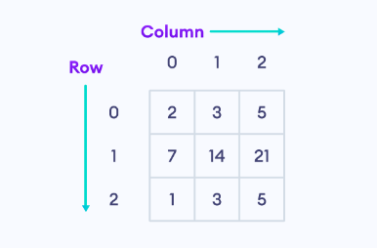
2-D Arrays
2-D array is used to represent matrix
A matrix is a two-dimensional data structure where numbers are arranged into rows and columns.
T Seshu Chakravarthy Department Of Computer Science and Engineering

Slide 59
Create Matrix in NumPy
import numpy as np
# create a 2x2 matrix
matrix1 = np.array([[1, 3],
[5, 7]])
print("2x2 Matrix:\n",matrix1)
# create a 3x3 matrix
matrix2 = np.array([[2, 3, 5],
[7, 14, 21],
[1, 3, 5]])
print("\n3x3 Matrix:\n",matrix2)
2x2 Matrix:
[[1 3]
[5 7]]
3x3 Matrix:
[[ 2 3 5]
[ 7 14 21]
[ 1 3 5]]
T Seshu Chakravarthy Department Of Computer Science and Engineering

Slide 60
NumPy Array Attributes
import numpy as np
# create a 2-D array
array1 = np.array([[2, 4, 6],
[1, 3, 5]])
# check the dimension of array1
print(array1.ndim)
# return total number of elements in array1
print(array1.size)
# return a tuple that gives size of array in each dimension
print(array1.shape)
# check the data type of array1
print(array1.dtype)
2
6
(2, 3)
int64
T Seshu Chakravarthy Department Of Computer Science and Engineering

Slide 61
Accessing the Elements of the Matrix
import numpy as np
A= np.array( [ [ 4, 5, 6 ], [ 7, 8, 9 ], [ 10, 11, 12 ] ] )
print ( "2nd element of 1st row of the matrix = “, A [0] [1] )
print ( "3rd element of 2nd row of the matrix = ", A [1] [2] )
print ( "Second row of the matrix = ",A[1] )
print ( "last element of the last row of the matrix =", A[-1] [-1] )
2nd element of 1st row of the matrix = 5
3rd element of 2nd row of the matrix = 9
Second row of the matrix = [7 8 9]
last element of the last row of the matrix = 12
T Seshu Chakravarthy Department Of Computer Science and Engineering

Slide 62
Matrix Operations using Numpy
Basic Matrix Operations
Addition
Subtraction
Multiplication
Division
Advanced Matrix Operations
Transpose
Inverse
T Seshu Chakravarthy Department Of Computer Science and Engineering

Slide 63
Addition of Matrices
Plus, operator (+) is used to add the elements of two matrices.
import numpy as np
X = np.array ( [ [ 8, 10 ], [ -5, 9 ] ] )
Y = np.array ( [ [ 2, 6 ], [ 7, 9 ] ] )
Z = X + Y #np.add(X,Y)
print (“Addition of Two Matrix : \n ", Z)
Addition of Two Matrix :
[[10 16]
[ 2 18]]
T Seshu Chakravarthy Department Of Computer Science and Engineering

Slide 64
Subtraction of Matrices
Minus operator (-) is used to subtract the elements of two matrices.
import numpy as np
X = np.array ( [ [ 8, 10 ], [ -5, 9 ] ] )
Y = np.array ( [ [ 2, 6 ], [ 7, 9 ] ] )
Z = X – Y #np.subtract(X,Y)
print (“Subtraction of Two Matrix : \n ", Z)
Substraction of Two Matrix :
[[ 6 4]
[-12 0]]
T Seshu Chakravarthy Department Of Computer Science and Engineering

Slide 65
Multiplication of Matrices
Multiplication operator (*) is used to multiply the elements of two matrices element wise.
import numpy as np
X = np.array ( [ [ 8, 10 ], [ -5, 9 ] ] )
Y = np.array ( [ [ 2, 6 ], [ 7, 9 ] ] )
Z = X * Y #np.multiply(X,Y)
print ("Multiplication of Two Matrix : \n ", Z)
Multiplication of Two Matrix :
[[ 16 60]
[-35 81]]
T Seshu Chakravarthy Department Of Computer Science and Engineering

Slide 66
Division of Matrices
Division operator (/) is used to divide the elements of two matrices element wise.
import numpy as np
X = np.array ( [ [ 8, 10 ], [ -5, 9 ] ] )
Y = np.array ( [ [ 2, 6 ], [ 7, 9 ] ] )
Z = X / Y #np. Divide(X,Y)
print ("Division of Two Matrix : \n ", Z)
Multiplication of Two Matrix :
[[ 4.0 1.66],
[-0.71 1.0]]
T Seshu Chakravarthy Department Of Computer Science and Engineering

Slide 67
Matrix Dot Products Calculation
@/dot() method is used to calculate dot Product of two matrices .
import numpy as np
X = np.array ( [ [ 8, 1 ], [ 5, 2 ] ] )
Y = np.array ( [ [ 2, 6 ], [ 7, 9 ] ] )
Z = X @ Y
print ("dot product of Two Matrix : \n ", Z)
dot product of Two Matrix :
[[23 57]
[24 48]]
T Seshu Chakravarthy Department Of Computer Science and Engineering

Slide 68
Transpose of a Matrix
It is nothing but the interchange the rows and columns of a Matrix
import numpy as np
X = np.array ( [ [ 8, 1 ], [ 5, 2 ] ] )
print ( " Original Matrix is : \n ", X)
print ( " Transpose Matrix is : \n ", np.transpose(X))
Original Matrix is :
[[8 1]
[5 2]]
Transpose Matrix is :
[[8 5]
[1 2]]
T Seshu Chakravarthy Department Of Computer Science and Engineering

Slide 69
Determinant of a Matrix in NumPy
It is nothing but the interchange the rows and columns of a Matrix
import numpy as np
A = np.array ( [ [ 8, 1 ], [ 5, 2 ] ] )
print ( " Original Matrix is : \n ", A)
print(" Determinant Matrix is : \n ",np.linalg.det(A))
T Seshu Chakravarthy Department Of Computer Science and Engineering

Slide 70
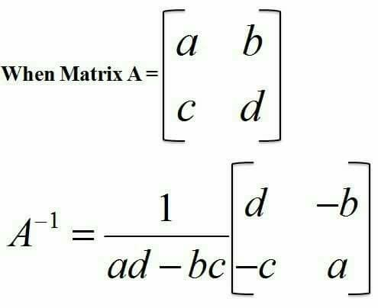
Inverse of a Matrix
import numpy as np
A = np.array ( [ [ 8, 1 ], [ 5, 2 ] ] )
print ( " Original Matrix is : \n ", A)
print(" Inverse Matrix is : \n ",np.linalg.inv(A))
Original Matrix is :
[[8 1]
[5 2]]
Inverse Matrix is :
[[ 0.18181818 -0.09090909]
[-0.45454545 0.72727273]]
T Seshu Chakravarthy Department Of Computer Science and Engineering

Slide 71
Reshaping arrays
Reshaping means changing the shape of an array.
The shape of an array is the number of elements in each dimension.
import numpy as np
arr = np.array([1, 2, 3, 4, 5, 6, 7, 8, 9, 10, 11, 12])
newarr = arr.reshape(4,3)
print(newarr)
[[ 1 2 3]
[ 4 5 6]
[ 7 8 9]
[10 11 12]]
T Seshu Chakravarthy Department Of Computer Science and Engineering

Slide 72
Write a python program to apply basic matrix operations on matrices
Addition of Two Matrix :
[[10 16]
[ 2 18]]
Subtraction of Two Matrix :
[[ 6 4]
[-12 0]]
Multiplication of Two Matrix :
[[ 16 60]
[-35 81]]
Division of Two Matrix :
[[ 4. 1.66666667]
[-0.71428571 1. ]]
dot product of Two Matrix :
[[ 86 138]
[ 53 51]]
Transpose Matrix is :
[[ 8 -5]
[10 9]]
Inverse Matrix is :
[[ 0.07377049 -0.08196721]
[ 0.04098361 0.06557377]]
import numpy as np
X = np.array ( [ [ 8, 10 ], [ -5, 9 ] ] )
Y = np.array ( [ [ 2, 6 ], [ 7, 9 ] ] )
print (“Addition of Two Matrix : \n ", X+Y)
print ("Subtraction of Two Matrix : \n ", X-Y)
print ("Multiplication of Two Matrix : \n ", X*Y)
print ("Division of Two Matrix : \n ", X/Y)
print ("dot product of Two Matrix : \n ", X@Y)
print ( " Transpose Matrix is : \n ", np.transpose(X))
print(" Inverse Matrix is : \n ",np.linalg.inv(X))
T Seshu Chakravarthy Department Of Computer Science and Engineering

Slide 73
Write a python program to apply basic matrix operations on matrices with looping
import numpy as np
X = np.array ( [ [ 8, 10 ],
[ -5, 9 ] ] )
Y = np.array ( [ [ 2, 6 ],
[ 7, 9 ] ] )
# Create a result matrix with the same dimensions
A = [[0, 0],[0, 0]]
S = [[0, 0],[0, 0]]
M = [[0, 0],[0, 0]]
D = [[0, 0],[0, 0]]
for i in range(len(X)):
for j in range(len(Y)):
A[i][j] = X[i][j] + Y[i][j]
S[i][j] = X[i][j] - Y[i][j]
M[i][j] = X[i][j] * Y[i][j]
D[i][j] = X[i][j] / Y[i][j]
print (“Addition of Two Matrix : \n ", A)
print ("Subtraction of Two Matrix : \n ", S)
print ("Multiplication of Two Matrix : \n ", M)
print ("Division of Two Matrix : \n ", D)
T Seshu Chakravarthy Department Of Computer Science and Engineering

Slide 74
# Program to transpose a matrix using a nested loop
X = [[12,7],
[4 ,5],
[3 ,8]]
result = [[0,0,0],
[0,0,0]]
# iterate through rows
for i in range(len(X)):
# iterate through columns
for j in range(len(X[0])):
result[j][i] = X[i][j]
for r in result:
print(r)
[12, 4, 3]
[7, 5, 8]
T Seshu Chakravarthy Department Of Computer Science and Engineering

Slide 75
Mathematical methods
sum(): It returns the sum of array elements.
max(): It finds the maximum element in an array
min(): It finds the minimum element in an array
mean(): It computes the arithmetic mean (average) of the given data
var() : It Compute the variance of the given data
std(): It computes the standard deviation of the given data
np.sort() : This function returns a sorted copy of an array.
T Seshu Chakravarthy Department Of Computer Science and Engineering

Slide 76
Write a python program to create an array with marks of 10 students . Find minimum,maximum,average,variance, standard deviation of marks. Print in ascending order also.
import numpy as np
a= np.array([15, 25, 36, 47, 58, 60, 75, 85, 95])
print("Max is:",np.max(a))
print("Min is:",np.min(a))
print("Average is:",np.mean(a))
print("variance is:",np.var(a))
print("SD is:",np.std(a))
print("After sortng :",np.sort(a))
Max is: 95
Min is: 15
Average is: 55.111111111111114
variance is: 650.9876543209876
SD is: 25.514459710544287
After sortng : [15 25 36 47 58 60 75 85 95]
T Seshu Chakravarthy Department Of Computer Science and Engineering

